Slide 1

C3.ai Financial Analysis
Presented to you by:
Gustavo Hernandez, Brandon Bekteshi, Giselle Saigh
Sep 2027

Slide 2

Agenda
01
The Perspective
02
Key Data From 10-k
03
10-k Financial Data
04
Ratio Analysis
05
Conclusion

Slide 3

The Perspective:
Does the business grow and expand over a 3–5 year horizon, and can it survive long enough to get there.
Long-term shareholder deciding whether to invest in C3.ai.

Slide 4
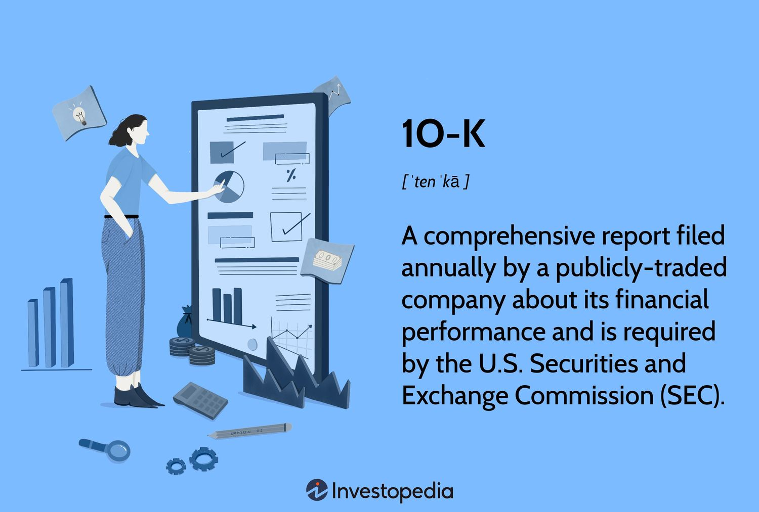
Key Data From 10-k
An average of 88.3% of revenue comes from sales
One customer makes up 14% of revenue - concentration risk
Cut 280 jobs in early 2026 - management is reacting to a problem
Add a relevant statement.
It could be a quote from a project lead or client
feedback.

Slide 5
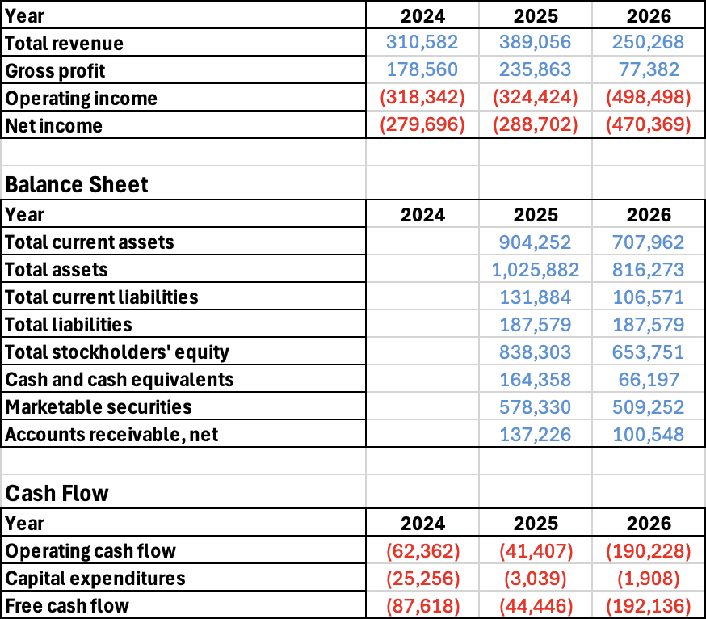
10-k Financial Data
(In Thousands)
What are the key takeaways?
Add another highlight from this quarter. For example, this could be a successful project. Use this slide to describe the project goals, challenges, and outcomes.
Revenue momentum dramatically fell in 2026 (total revenue)
Increasingly negative returns from operating (operating income)
Cash collapsed nearly 60%, weakening liquidity (cash and cash equiv)
Day to day operations 359% in 2026 compared to the previous year (operating cash flow)

Slide 6
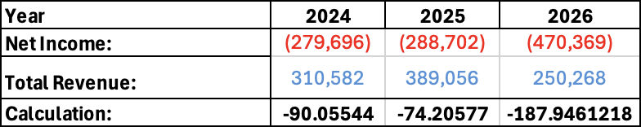

Net Margin Ratio
Net Margin = (Net Income / Total Revenue) x 100
What does this mean?
In the year 2024, for every $1 brought in, the company spent $1.90 to keep the business running.
As time progresses, the expenditure is outpacing revenue . This suggests that long-term operating my not be feasible.

Slide 7
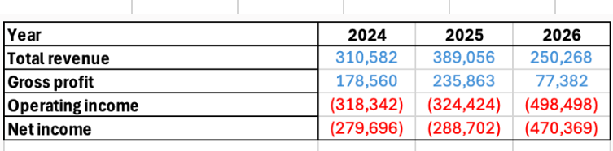
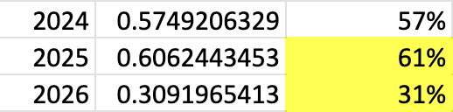
Gross Margin
Gross Margin Ratio =
Gross Profit / Total Revenue
Gross margin increased from 2024 to 2025 with a 4% increase, showing improved profitability at gross-profit margins.
Gross margin dropped significantly from 2025 to 2026 by approximately 30%
2025- For every dollar in revenue, $0.61 remained as gross profit before operating expenses.
2026- For every dollar in revenue only $0.31 remained as gross profit.
  Decline in the companies profitability
  Increases risk of long term investment
+ 4%
-30%

Slide 8
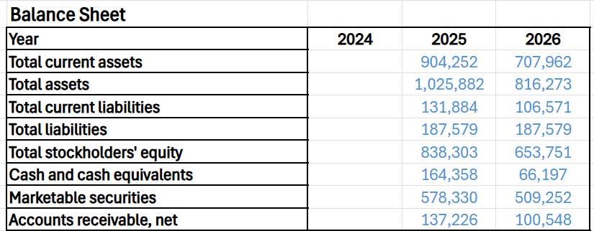
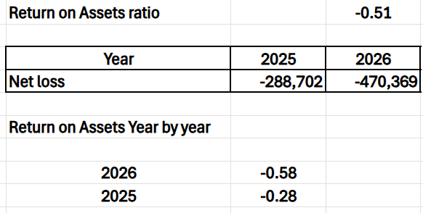
Return on Assets ratio
ROA= net loss/total assets
-470,369/816,273+1,025,882/2= -51%
The result of ROA indicates that C3.ai is consuming it’s asset base rather than focusing on returns for their own company. The drops in both years means no net profitability as well for the company and because of this, this is treated as a high risk investment until they are able to stabilize their losses.

Slide 9
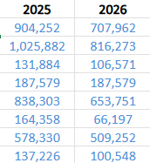

Return on Equity Ratio
NET INCOME AND AVG. EQUITY
ROE= NET INCOME/ AVG STOCKHOLDERS’ EQUITY X 100
AVG EQUITY= 838,303 + 653, 751/2 = 746,027
ROE= (-288,702/746,027)= -38.70%
The result of the ROE indicates that the company reported a loss than generating positive return on its stockholders’ equity. In other words, for every $1 for a stockholders’ equity, C3. ai generated an estimate loss of $0.387 in 2025.

Slide 10

Conclusion
Declining cash flow → The business may be spending more cash than it generates
Profit margins → making less profit per dollar of revenue could be a concern for long term shareholders. There is big uncertainty.
ROA-
C3.ai has strong liquidity, but it appears too risky for a long-term investment due to the significant decline in revenue, profit margins, and cash flow in 2026.

Slide 11
Thank
you

